Slide 1
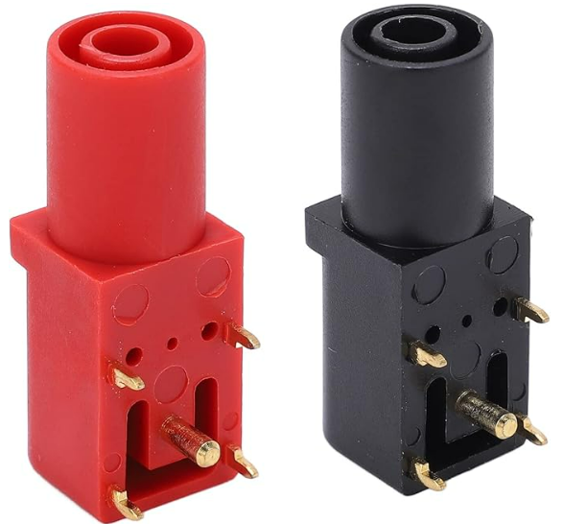
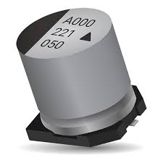
SYSTEM EXT PWR
BULK CAP STORAGE
- LAB SUPPLY 1
20V 3A(MIN)
- MAIN SUPPLY RAIL
+ LAB SUPPLY 2
20V 3A(MIN)
5V REGULATOR
1A
5V SYSTEM PWR
+ MAIN SUPPLY RAIL

Slide 2
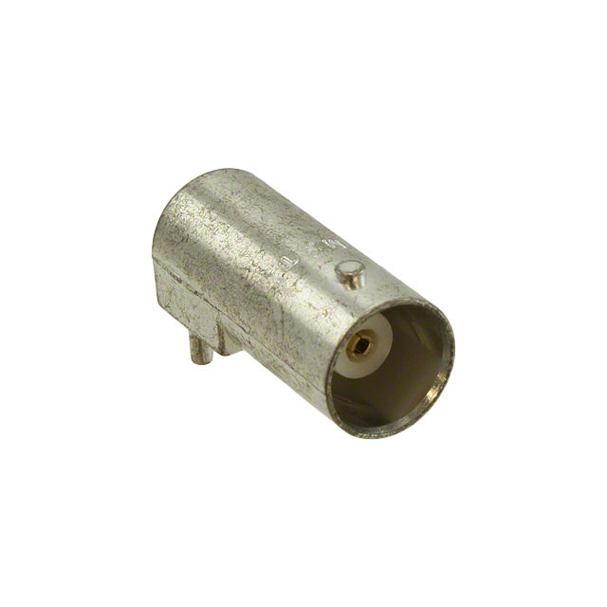
INPUT Z
SWITCHED
50Ω / 1MΩ
Av = 1
DIGITAL
VOLTAGE
DIVIDER
Av = 1
Current
Boost
CURRENT
SENSE
OUTPUT
DISCONNECT
CH1 IN
CH1 OUT
I2C
UI INTERFACE MODULE
STM32F746G-DISCO
ADC
5V SYSTEM PWR
ADC
I2C
INPUT Z
SWITCHED
50Ω / 1MΩ
Av = 1
DIGITAL
VOLTAGE
DIVIDER
Av = 1
Current
Boost
CURRENT
SENSE
OUTPUT
DISCONNECT
CH2 IN
CH2 OUT

